Slide 1

A0100

Slide 2


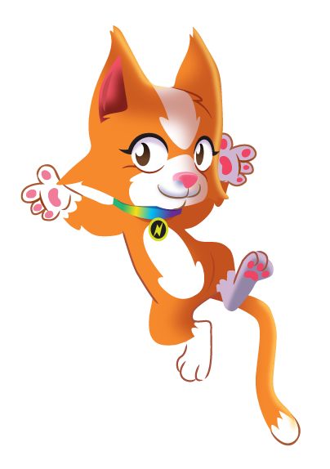

At the heart of
Power Maths
is the belief that all children can achieve.
It’s built on an exciting growth mindset and
problem-solving approach.
Notes:
Power Maths is an interactive, whole-class teaching model.
It encourages precise mathematical language and allows children to deepen their understanding as far as they can.
By working hard, all children can achieve.

Slide 3
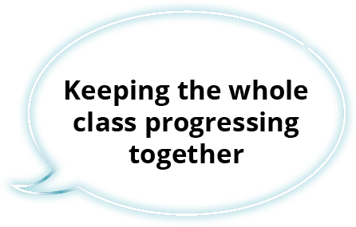
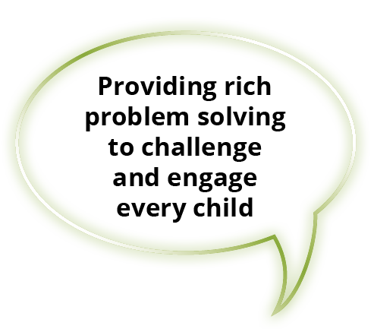
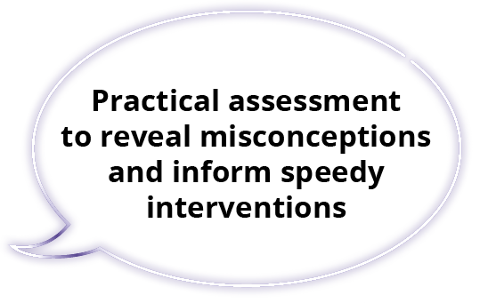
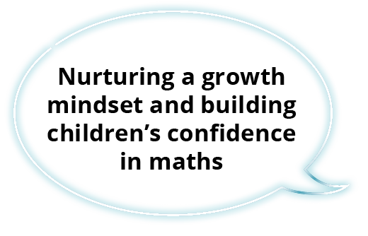
Key aims of Power Maths
Notes:
Builds every concept in small, progressive steps to help keep the whole class together.
Helps children problem-solve by building on prior learning to help them see connections and patterns.
Teachers can check understanding throughout the lesson to ensure all children are keeping up.
Power Maths aims to spark curiosity and encourages rich mathematical talk.

Slide 4

In a nutshell …
An exciting whole-class mastery approach for Reception to Year 6
Written by mastery experts and inspired by best practice from around the world
Fully recommended by the Department for Education
Created specifically for UK classrooms
Makes maths an adventure and helps build a culture of excitement and confidence!
Notes:
Power Maths is aligned with the National Curriculum, and is a whole-class mastery resource to empower every child to understand and succeed in maths.

Slide 5


What is mastery?
“Mastering maths means acquiring a deep, long-term, secure and adaptable understanding of the subject” – NCETM
We achieve this by …
Carefully
sequenced,
small step
learning
Representation
that expose
mathematical
structures
Developing
mathematical
thinking
Building
fluency

Slide 6
Growth mindset
Fixed mindset
Growth mindset
“I’m not good at maths – I’ve never been good at maths”
“I’m finding maths hard now, but I can improve with time and effort”
“I give up – I can’t make this any better”
“I can improve if I keep trying”
“If I fail I am a failure”
“Most successful people fail along
the way”
“I can’t do this – I keep making mistakes”
“Mistakes help me learn”
Notes:
The growth mindset approach encourages children to see mistakes as learning opportunities. It promotes hard work and practice, and discourages the idea that some people ‘can’t do maths’.

Slide 7

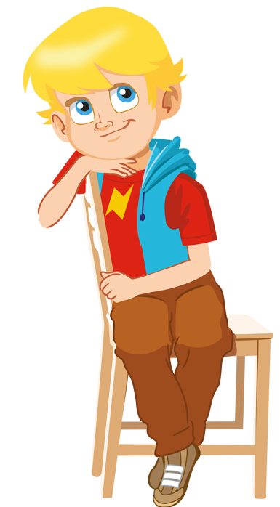
Meet the growth-mindset characters!
Flo
Flo is flexible and creative. She often with new methods to solve problems.
Dexter
Dexter is determined. When he makes a mistake he learns from it and tries again.
Can we do it differently?
Let’s try again!
Notes:
The growth mindset characters help build mathematical confidence so every child can reach their potential.
They are allies for our children and are all hard-working, enthusiastic and unafraid of making mistakes!

Slide 8
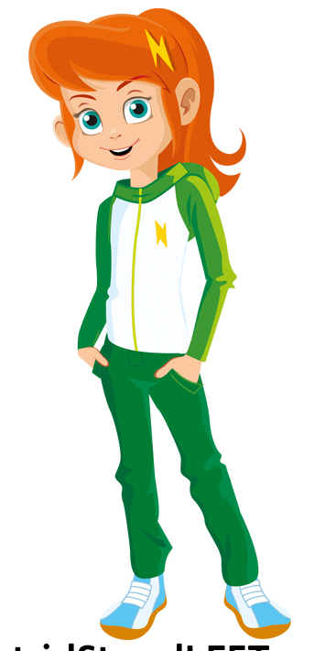
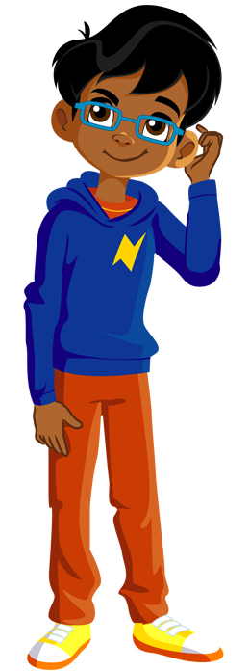
Meet the growth-mindset characters!
Astrid
Astrid is brave and confident. She is not afraid to make mistakes.
Is there a pattern?
I will share my ideas!
Ash
Ash is curious and inquisitive. He loves to explore new concepts

Slide 9


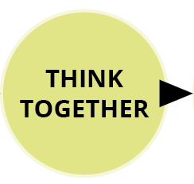
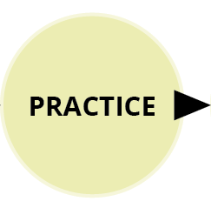

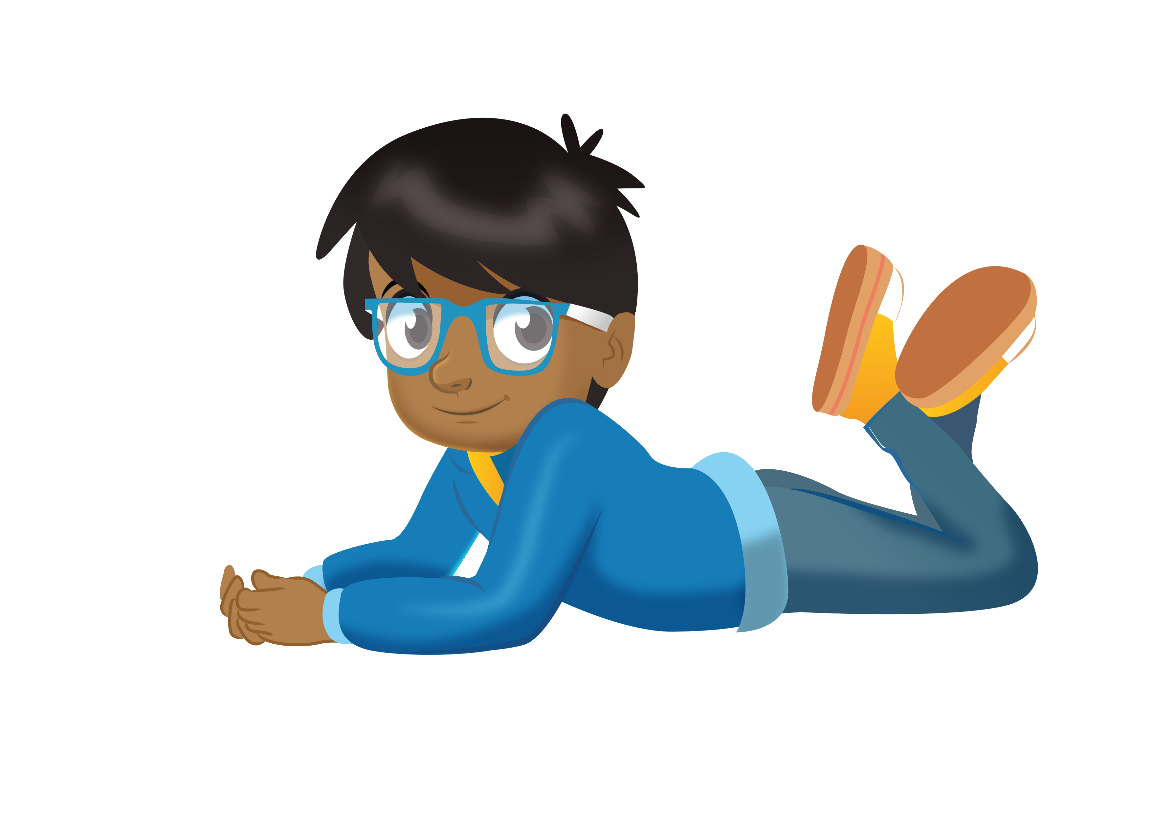
See the lesson structure
Notes:
A consistent structure for delivering a whole-class mastery approach in which no child is left behind. Each lesson follows the same format, which we will show in the following slides.
Same-day interventions help us keep the class progressing together, so Power Maths provides plenty of support throughout the journey.

Slide 10
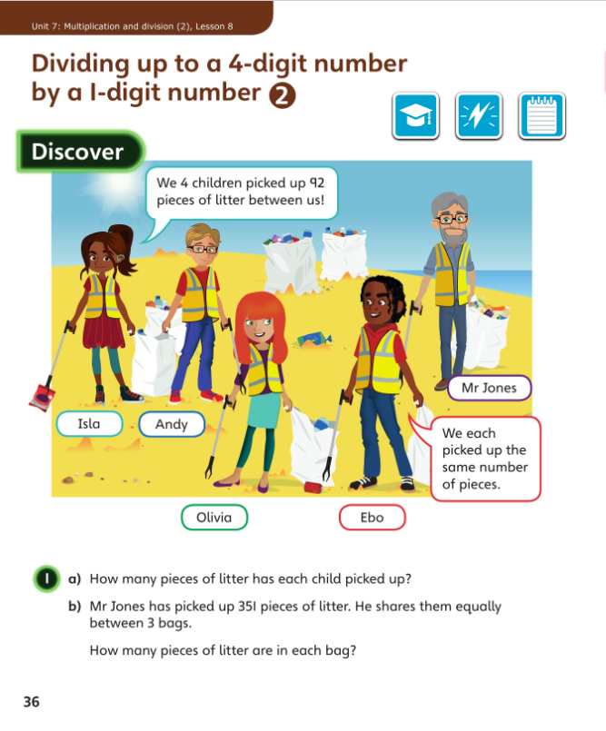
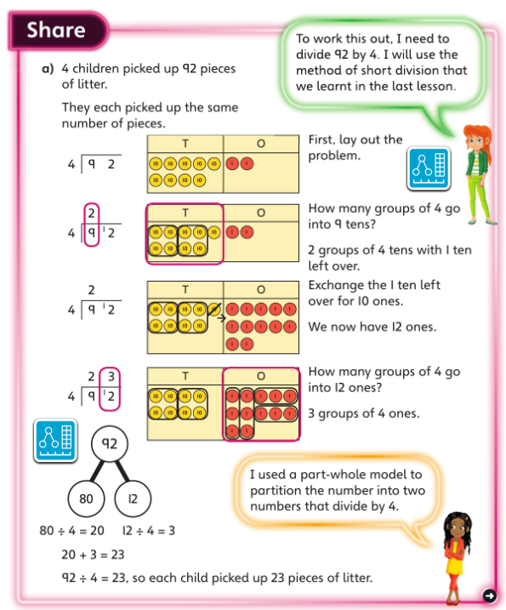
Discover and Share
Concrete-Pictorial-Abstract approach
Engaging scenarios
Notes:
In Discover, appealing real-life scenarios stimulate curiosity, helping children to identify the maths problem and discover patterns and relationships for themselves.
The concept is introduced logically using a Concrete-Pictorial-Abstract approach to help children to make connections and grasp concepts.
Here in Share part a), children are shown the pictorial representation of place value counters alongside the more abstract method of short division. The Power Maths characters provide support and help children to develop a growth mindset by encouraging them to think, reason and reflect.

Slide 11
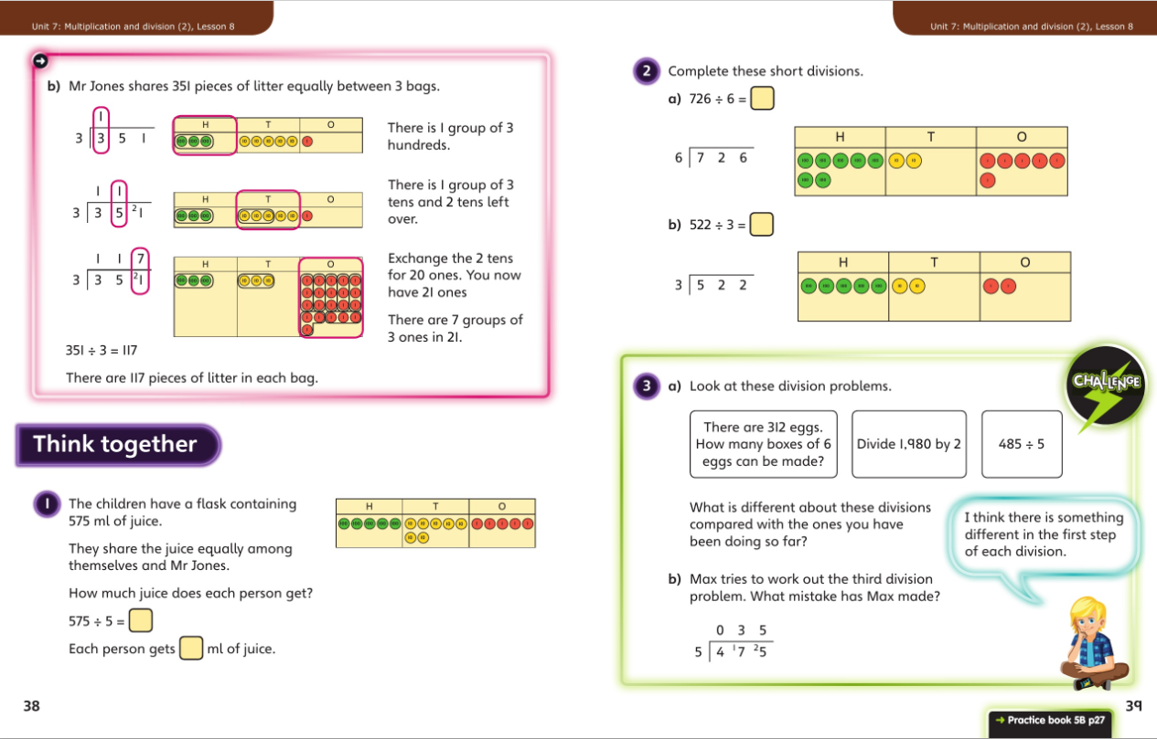
Think together
Friendly, supportive characters help children develop a growth mindset.
Notes:
In Think together, the scaffolding is gradually reduced as children become more familiar with the mathematical concept. We encourage children to talk together to explain how they solve the problems.
Throughout, maths language is used consistently to encourage all children to use the correct terms and feel comfortable with them.

Slide 12
Questions are presented in a logical sequence.
Practice
Calculations are connected so that children think about the underlying concepts.
Notes:
This is continued in the Practice Books, where each question varies one small element to move children on in their thinking.
Children complete intelligent practice independently, ending in a Reflect section where children reveal the depth of their understanding before moving on.

Slide 13
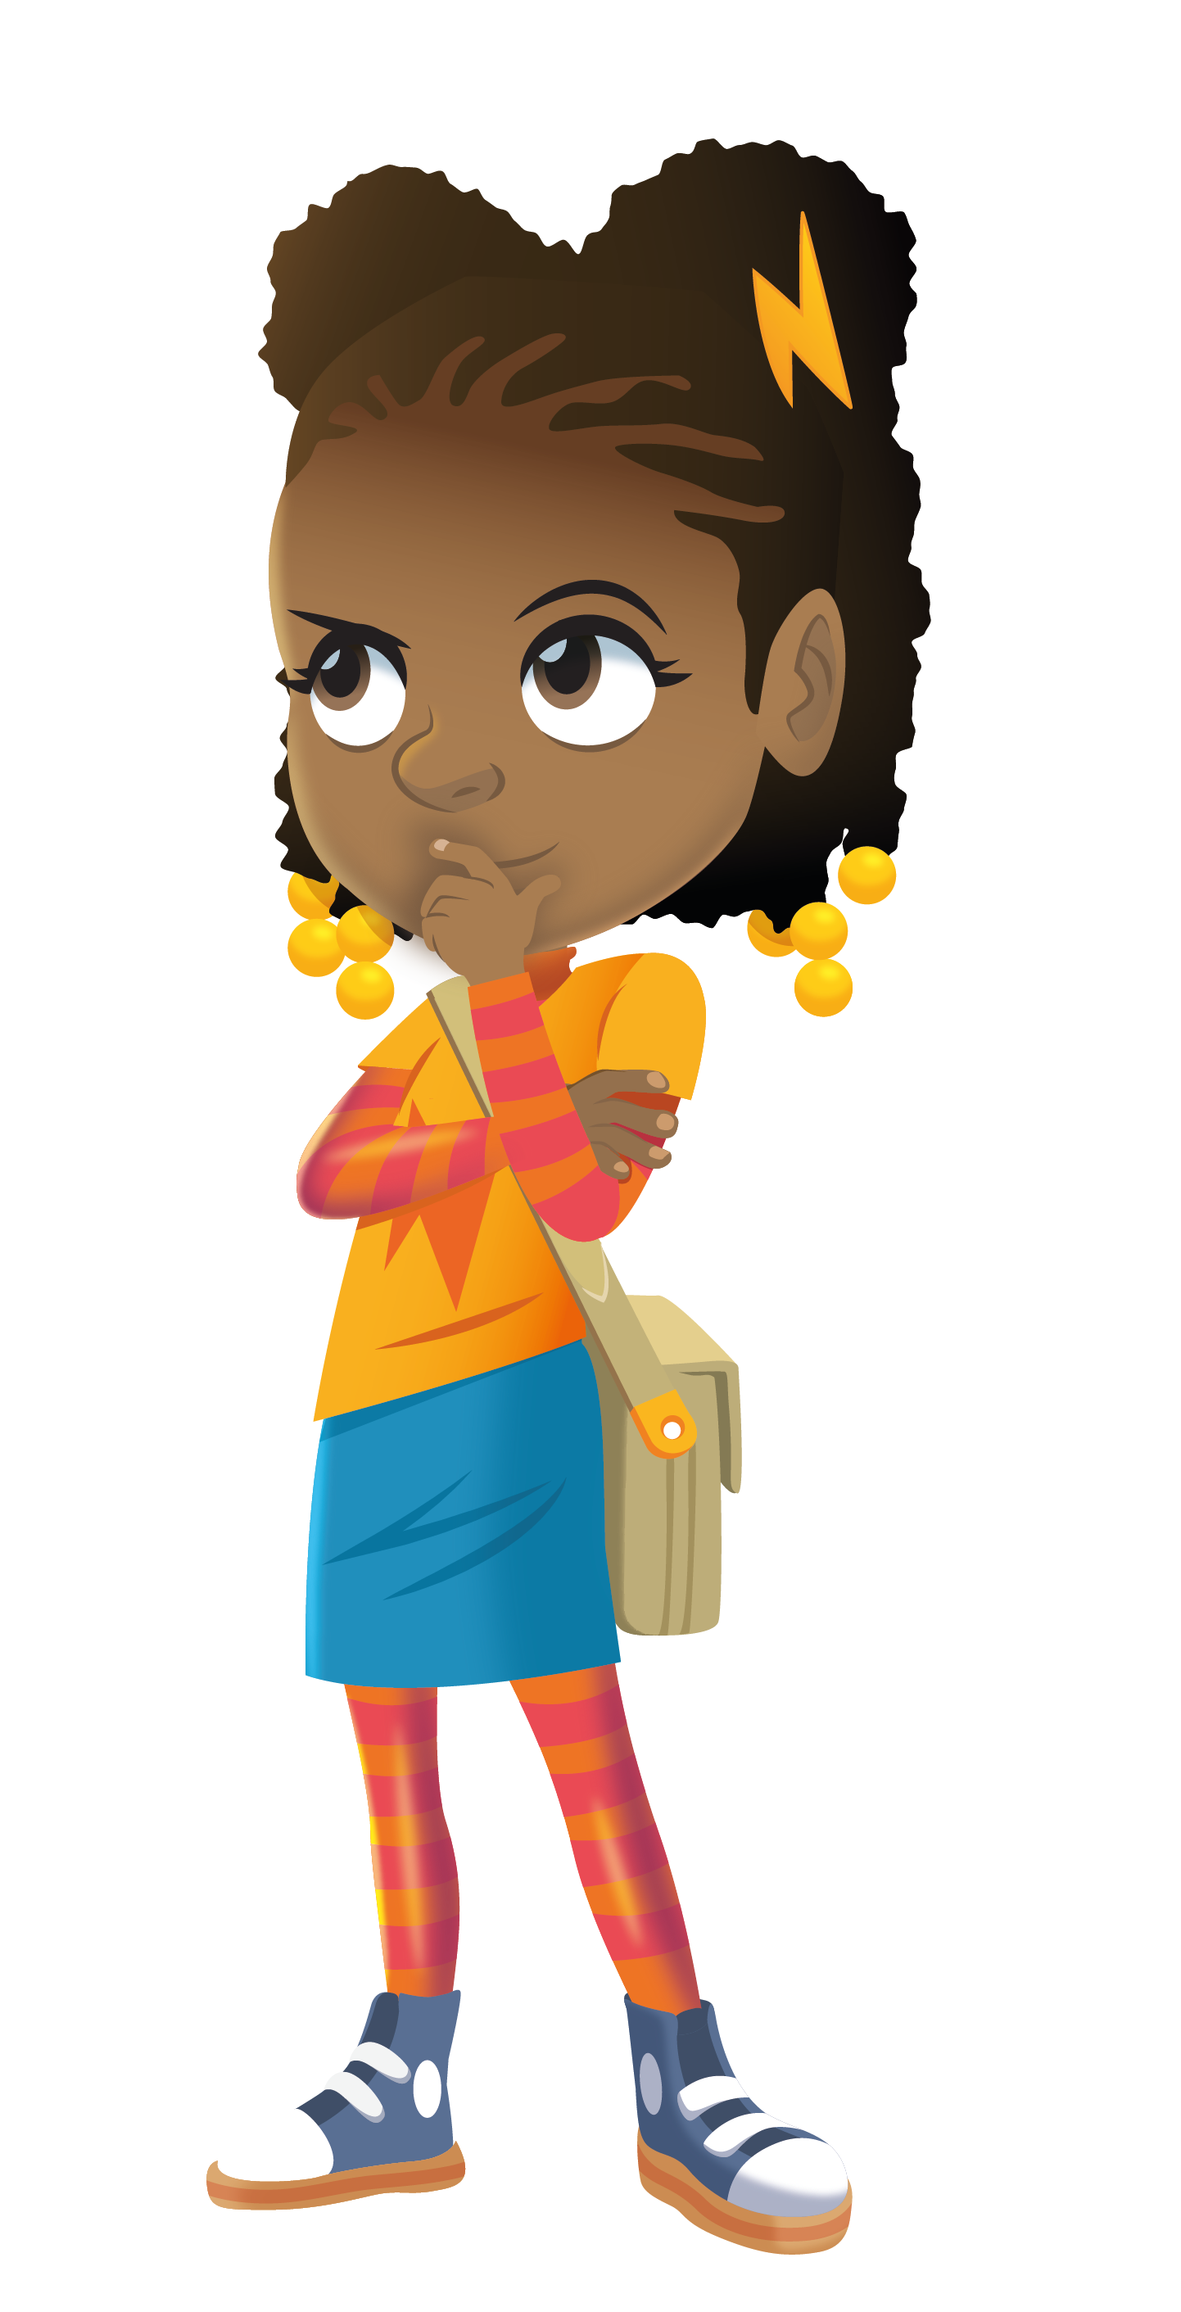
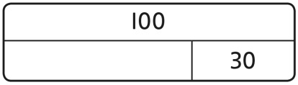
Models and representations
Part-whole models
Shows how numbers can be split into parts. Helps show the connection between addition and subtraction.
7
3
Bar models
Helps show
the maths
problem as
a picture.
Notes:
Children will be meeting mathematical models and representations which you might not yet be familiar with. Here are two examples: a part-whole model and a bar model.
These models help children to visualise the problem and explain their working.

Slide 14
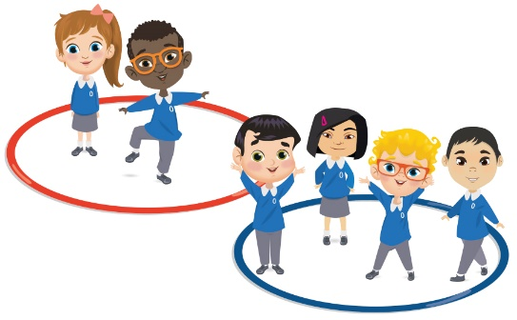
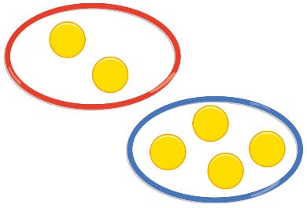
Models and representations
2
6
2 + 4 = 6
4
Notes:
Children are encouraged to solve problems each day through the use of concrete resources, pictorial representations and abstract thinking (the C-P-A approach). This helps children tackle concepts in a tangible and more comfortable way.
C = Concrete. A familiar object that a child can manipulate to help bring the maths to life. Children make the connection between the number and the object. It could be cakes, cars or children!
P = Pictorial. This uses pictorial representations and diagrams of objects to ‘see’ what maths problems look like. This might be drawn counters which represent each child in the maths problem.
A = Abstract. The ultimate goal is for children to understand abstract mathematical concepts and symbols.

Slide 15
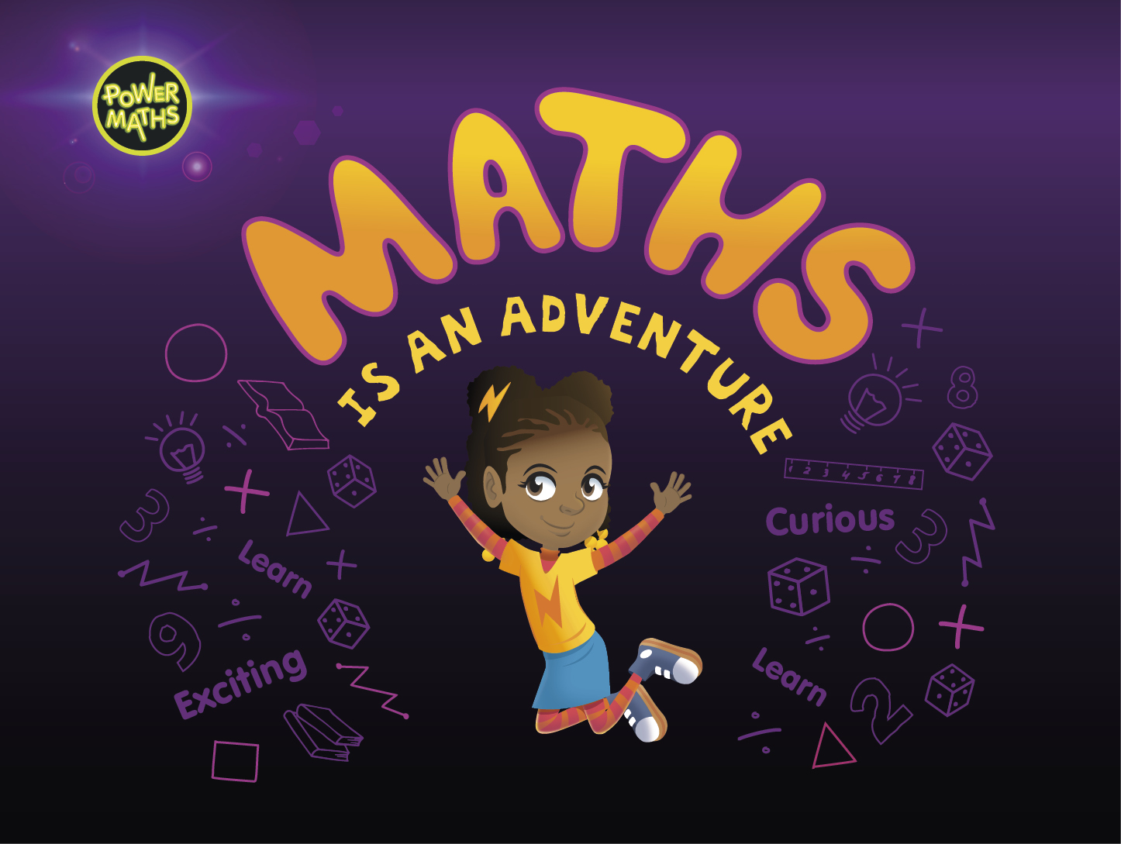
A0100
Notes:
We hope your children enjoy working with Ash, Dexter, Astrid and Flo to master maths.

