Slide 1
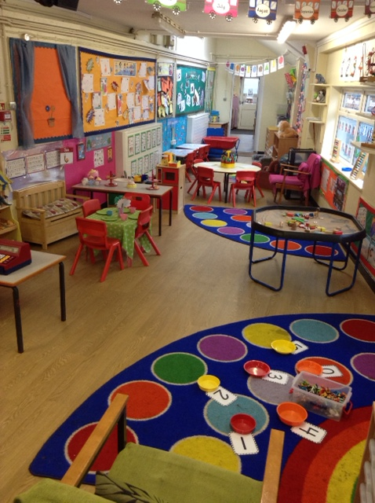
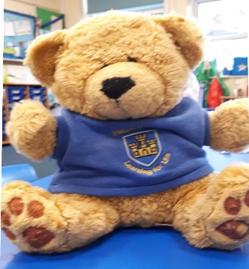
Starting School
A Day in Nursery
I’m Harold, the Hassell bear
Insert a photo of yourself here.

Slide 2
Welcome to
Nursery
My name is Mrs Boden and I will be one of your key workers.
I can’t wait to meet you!
☺
Mrs Boden

Slide 3
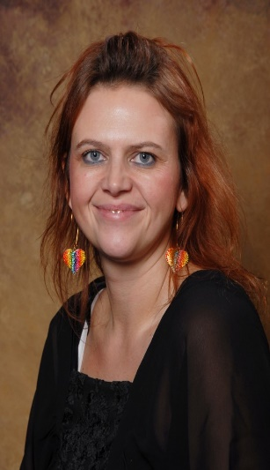
Welcome to
Nursery
My name is Mrs Heath and I will be one of your key workers.
I can’t wait to meet you!
☺
Mrs Heath

Slide 4
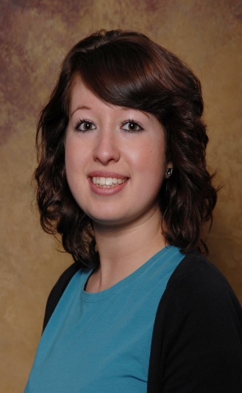
Welcome to
Nursery
My name is Miss Tune and I will be one of your key workers.
I can’t wait to meet you!
☺
Miss Tune

Slide 5
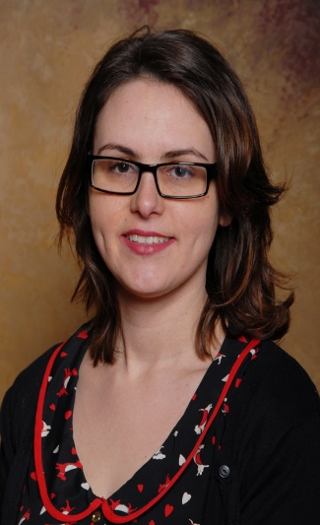
Welcome to
Nursery
My name is Miss Ryan and I am the Reception class teacher and Early Years leader. I support the nursery staff. So you may see me sometimes too.
Let me tell you what a day in Nursery looks like.
Miss Ryan

Slide 6
Good morning!
When you come to school in the morning, you need to walk through the playground and find our classroom door.
Mrs Delves will be there to see you. You will see some adults who work in our class too, such as Mrs Boden.
You will be in your school uniform.
I’m Harold, the Hassell bear
Insert a photo of yourself here.
Find uniform details here
Buy uniform from here or here or any supermarket.

Slide 7
Coming into class
When you come to school in September you will come into the school, over the ‘big yard’ and into the infant yard pictured below. Parents are kindly asked to stop at the classroom door. (due to social distancing)
Parents, children usually settle in really well, please don’t worry. We will contact you with any concerns. We find the best thing is to have a big smile and hug and say bye,bye.
.
Mrs Delves will be waiting for you here.
The Nursery Entrance

Slide 8
When you come into the classroom, you will need to take off your coat and hang it on your peg. Each child in our class has their own peg. You will put your lunch bag (if you have one) and water bottle on the trolley and your school book bag in the box. The adults will make sure everyone knows what to do. (Theses things are needed everyday, please label all items)
The school book bags are the perfect size to fit in your reading folder
School book bag

Slide 9
Our next job is to do the register. We sit on the carpet and say good morning to each other. Your teacher will tell you what we will be learning for that day and all of the fun activities that will be available. Your teachers will give you lots of help throughout the day. Our learning takes place inside and out. You’ll have so much fun!
Insert a photo of yourself here.
Insert a photo of register time.
Insert a photo of school office/office staff.

Slide 10
Timetable for a typical day
8:50 – 9:00 Children (arrive over via the yard am routine)
8:50 – 9:00 Register is taken
9:00 – 10:30 Phonics (adult directed and child choice)
10:30 – 10:45 Break (fruit and milk)
10:45 – 11:30 Maths focus & (adult directed and child choice)
11:45 – 12:55 Lunch or 11:50 Morning children go home
12:55 – 13:00 Register is taken
13:00 – 14:45 Maths & Prime areas core teaching & CP
14:45 Children are collected (wrap around care & clubs)

Slide 11
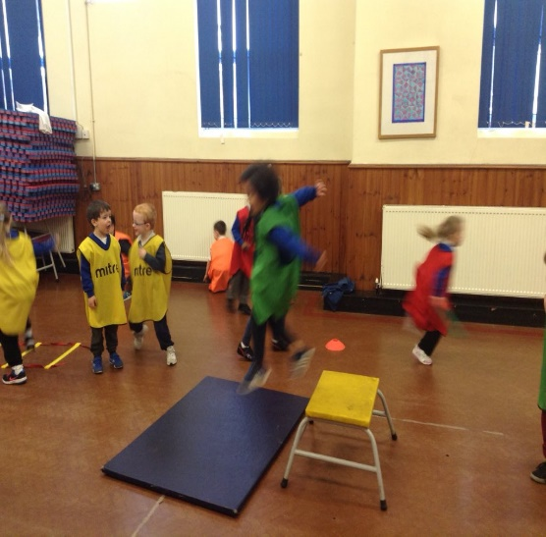
PE day is Thursday
Our 1st PE session will be Thursday the 10th September and then weekly from that date onwards. On a Thursday please send your child dressed in their PE kit.
PE lessons are provided by our specialist coaches. LMA
Insert a photo of yourself here.
Insert a photo of register time.
Insert a photo of school office/office staff.

Slide 12
Lunch time
At lunch time, if your child is staying at school for the full day the staff stay with the children. A school meal costs £2.45 per day. You are welcome to send your child with a healthy packed lunch. We are a NO NUT school. We have children and staff with allergies including Miss Ryan. Thank you for helping to keep us safe.
Our lunches are provided by AIP, find details here.
Insert a photo of yourself here.
Insert a photo of register time.

Slide 13
What we will learn in Nursery class
Insert a photo of yourself here.
In Nursery all of our lessons are linked to the children's needs and interests with the aim of reaching or exceeding the ELGs by the end of the foundation stage (Reception) At Hassell we have adopted the new Early Learning Goals.
. The Statutory Framework for Early Years can be found here. The what to expect when document is very helpful and gives you an insight into how your child may progress. Please contact Miss Ryan if you would like more information.
Topic information will be set out at the beginning of each half term.
EYFS – Areas of learning here

Slide 14
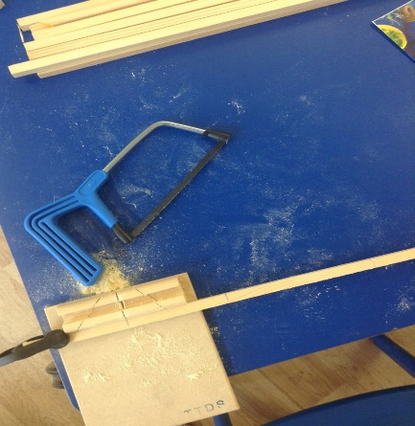
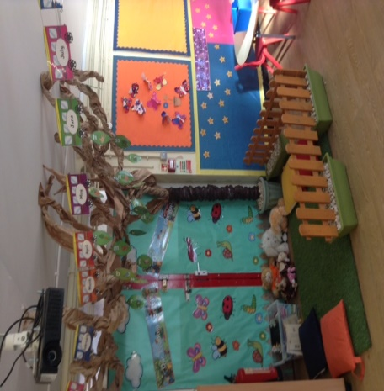
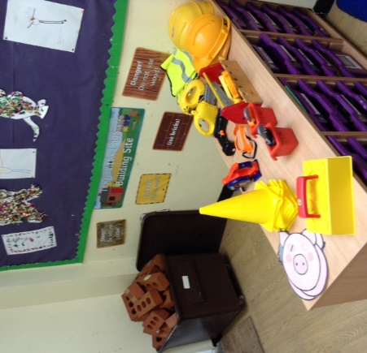
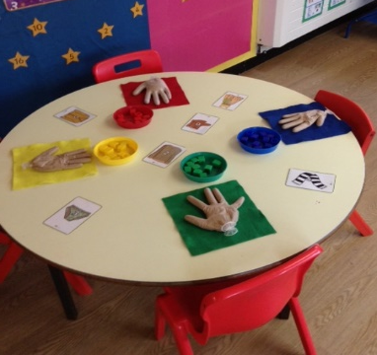
Insert a photo which shows a different area or resource.
Creative area
Our book corner
Role play
In the classroom, there are lots of things for you to explore and help you with your learning.
Insert a photo which shows a different area or resource.
Insert a photo of yourself here.
Maths area

Slide 15
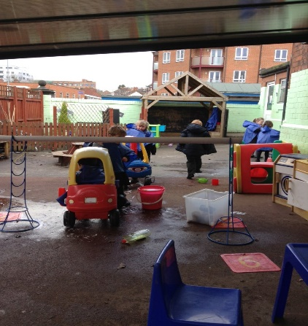
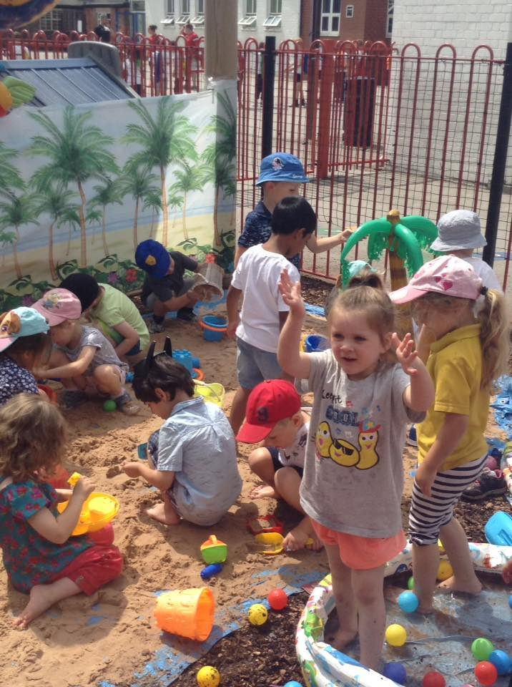
Insert a photo which shows a different area or resource.
Car wash
At the beach
Water wall
In the outdoor classroom, there are lots of things for you to explore and help you with your learning.
Insert a photo of yourself here.
Nursery outdoor classroom

Slide 16
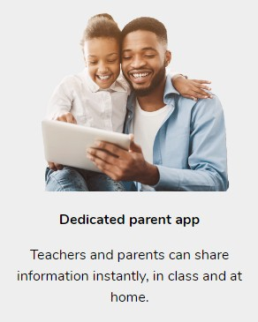
Home- School Links!
We’ve started to use a new system which will allows us to share what your child is doing in school.
The ‘Parent Share’ feature in Evidence Me enables you to view reports (complete with photos) via the app or web suite, showing you what your child has been learning and the new skills they are developing.
We think these reports will really brighten up your day!
We will send a letter with full details in September.
Insert a photo of yourself here.
Insert a photo of register time.
Find information on
the parent app here

Slide 17
What does school readiness mean?
You may have heard the term school readiness, below are some of the things that a child of nursery age may be able to do. If they are not at that stage yet please don’t worry, we are here to help. Please may we ask that you tell your class teacher if your child is not toilet trained so that we can make plans to ensure they are comfortable and happy. Please ensure you tell us about medical conditions and allergies on your application form.
Put on/take off your coat.
Put on/take off your jumper/cardie.
Begin to take care of own belongings.
Use a knife & fork.
Drink from a cup.
Use the toilet independently.
.
Notes:
Put on/take off your coat.
Put on/take off your jumper/cardie.
Begin to take care of own belongings.
Use a knife & fork. Drink from a cup.
Use the toilet independently.

Slide 18
Covid-19
Extra cleaning
Careful selection of resources
Rotation and cleaning of resources
Handwashing
Catch it, bin it, kill it.
Key Stage bubbles
Social distancing for parents
Mental health and wellness support
If you have and questions or concerns relating to Covid-19 and the measures taken in school please contact Mrs Broome on headteacher@hassell.staffs.sch.uk
Insert a photo of yourself here.

Slide 19
If you need wrap around care. Care club is available for any child who attends our school. It provides a high quality of care with the emphasis on fun activities and enjoyable pastimes.
Click here for details
Care club
You have automatic membership of Hassell Community Primary School Parent, Teacher & Friends Association (PTFA) Watch out for details on the school Newsletter in September and beyond.
Find detail here for the PTFA

Slide 20
Transition
We are so sad that we couldn’t hold the stay and play sessions during the summer term. We hope to invite families to visit during the last week of the summer holidays.
Mrs Broome will send out an invite soon.
Click here for starting school support.
Insert a photo which shows yourself with a task for children to complete.
.

Slide 21
We are really looking forward to seeing you in September. Feel free to contact me (Miss Ryan) over the summer holidays and I’ll get back to you as soon as I can.
missryanhassell@gmail.com
Insert a photo which shows the playground.
Insert a photo of yourself here.
We can’t wait to see you!

